Slide 1
Exploratory Data Analysis of Spotify Dataset
By
Samman Das | Team Hephaestus | The Manhattan Project

Slide 2
Problem Statement
This project is a deep dive into Exploratory Data Analysis (EDA) using a dataset of Spotify tracks. The goal is to perform a comprehensive analysis to understand the characteristics of the tracks, identify key relationships between different audio features, and uncover insights that could be used for tasks like music recommendation or understanding music trends.

Slide 3
Agendas
Data Descriptions
Univariate Analysis
Bivariate Analysis
Multivariate Analysis
Time Series Analysis
Final Recommendations

Slide 4
Data Descriptions
It’s All About Raw Data

Slide 5
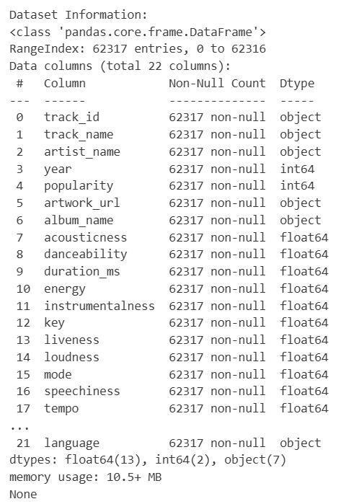
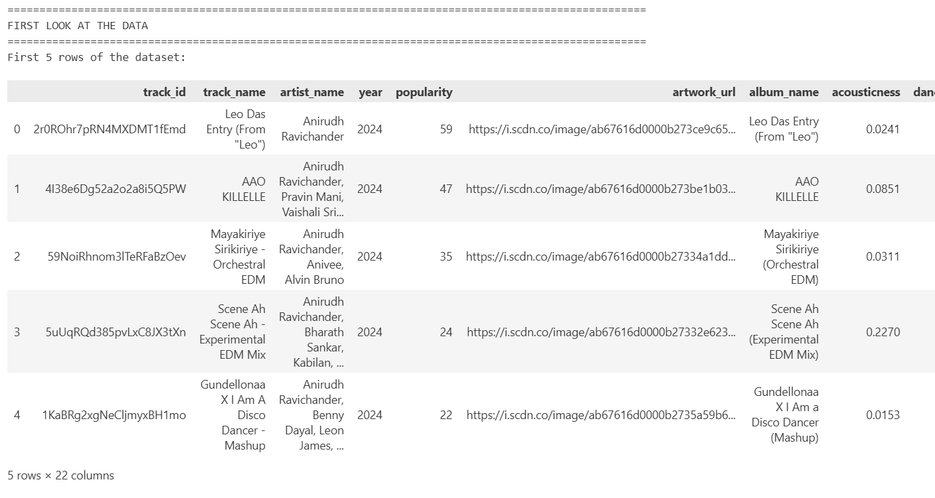
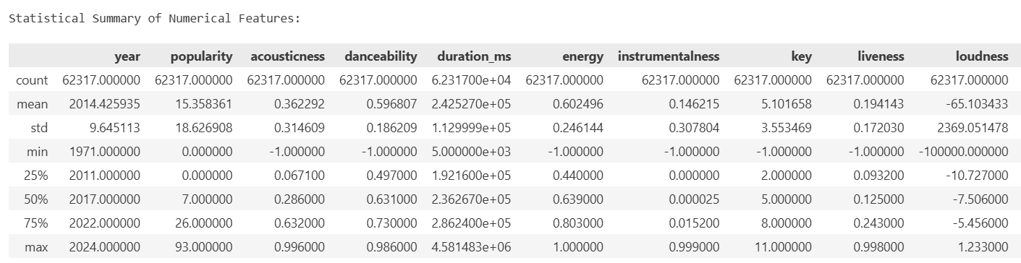
Data Descriptions
It’s just demo pictures from the Jupyter™ File as the outputs are truncated…

Slide 6
Data Descriptions
Acousticness, danceability, energy, instrumentalness, liveness, speechiness, valence, tempo, loudness, duration_ms, popularity, year
Variable
Numerical
Categorical
track_id, artists, album_name, track_name,
Language, mode, time_signature, key

Slide 7

Univariate Analysis
Unlocking new insights

Slide 8
What is Univariate Analysis ?
How THINGS ARE DONE HERE ?
Step 1
Popularity Distribution Analysis
Step 2
Audio Features Distribution
Step 3
Categorical Features Visualization
Step 4
Statistical Summary
Univariate analysis is the simplest form of data analysis, where you look at only one variable at a time. The goal is to understand the distribution, central tendency, and spread of that single variable, without worrying about its relationship with others.

Slide 9
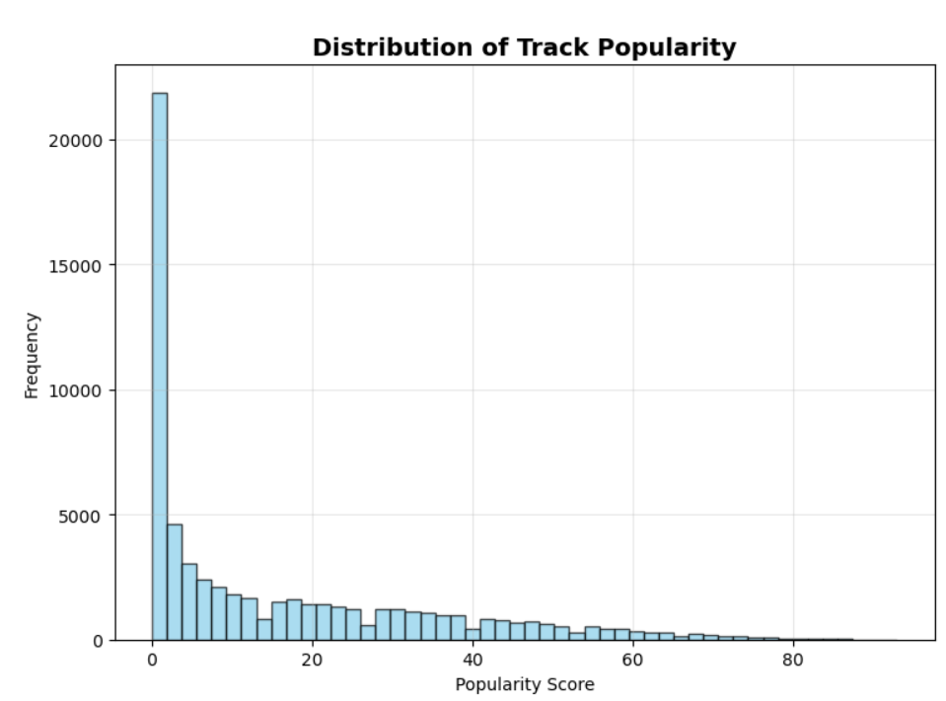
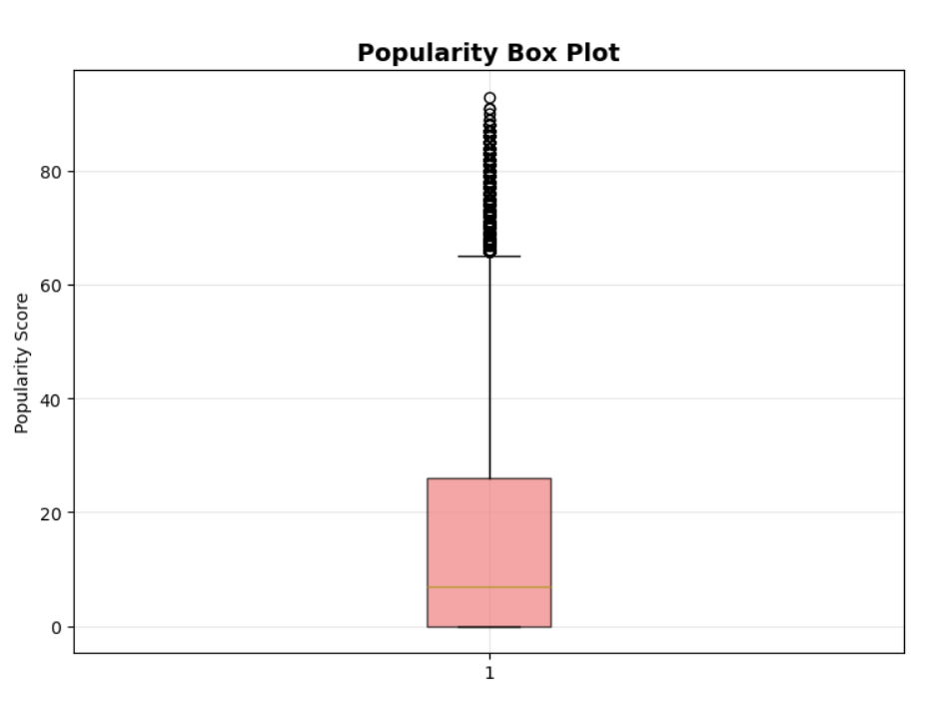
Popularity Distribution Analysis
Shows frequency distribution of popularity scores
Pattern: Right-skewed distribution with most tracks having low popularity
Peak: Large concentration of tracks at popularity score 0
Range: 0-100 popularity scale
Shows statistical summary with quartiles and outliers
Median: Around 10-15 (low popularity)
Outliers: Many high popularity tracks (>75) shown as dots
IQR: Most tracks fall between 0-30 popularity range

Slide 10
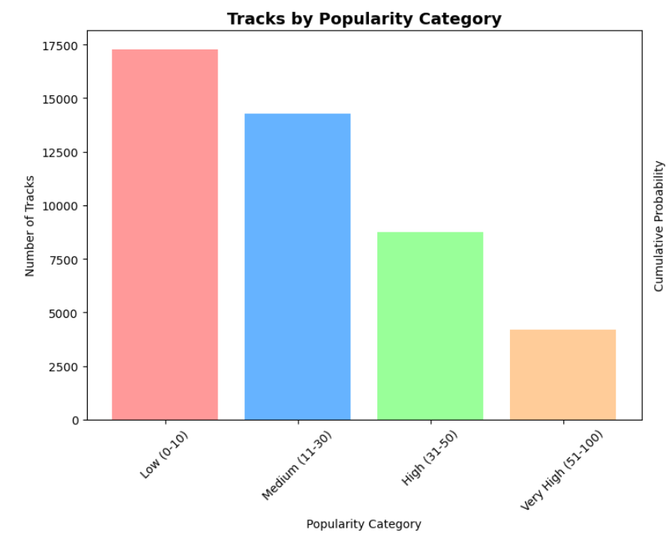
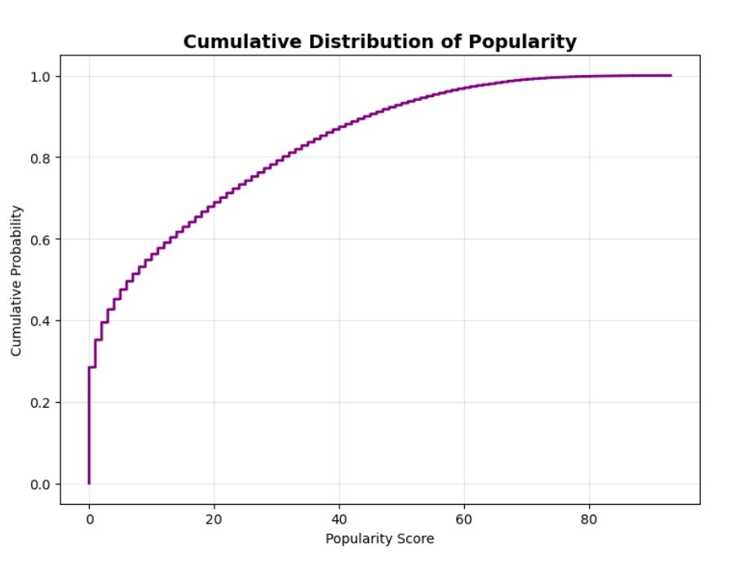
Popularity Distribution Analysis
Shows count of tracks in each popularity bin
Categories: Low (0-10), Medium (11-30), High (31-50), Very High (51-100)
Pattern: "Low" category dominates with highest count
Colors: Different colored bars for each category
Shows cumulative probability from 0 to 1
Shape: Steep rise initially, then gradual increase
Interpretation: ~80% of tracks have popularity ≤50
Pattern: Confirms most tracks have low popularity scores

Slide 11
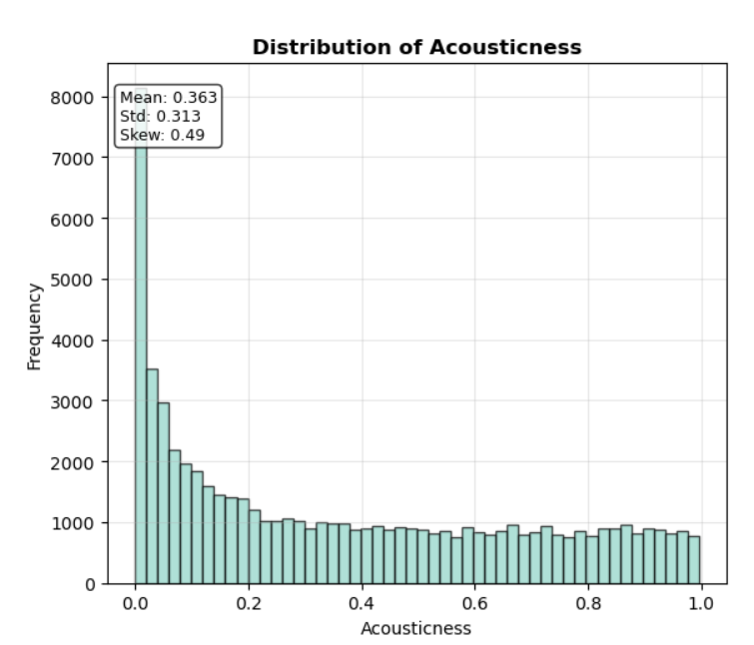
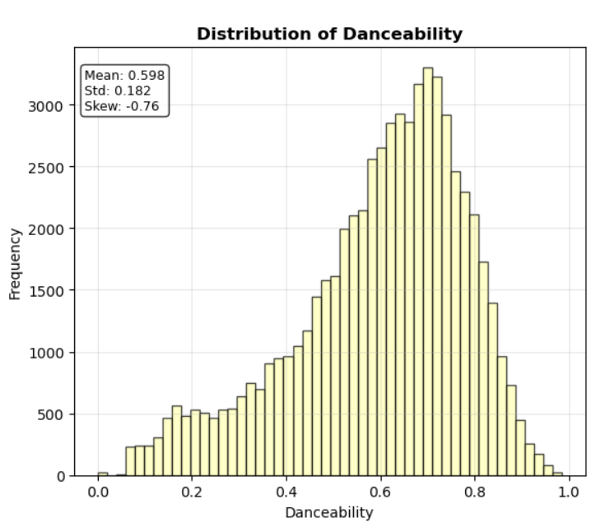
Audio Feature Distribution
Acousticness
Pattern: Right-skewed distribution
Peak: Heavy concentration near 0 (most tracks are not acoustic)
Shape: Long tail extending toward 1.0
Danceability
Pattern: Normal/bell-shaped distribution
Peak: Around 0.5-0.7 range
Shape: Most balanced distribution among audio features

Slide 12
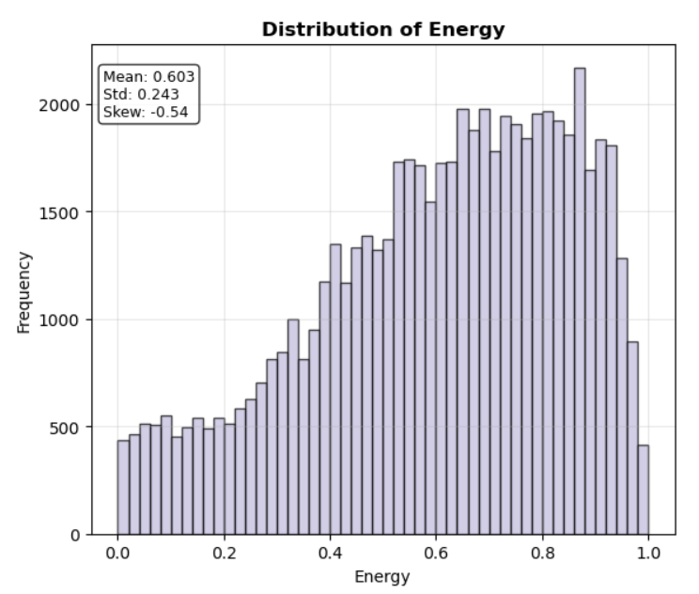
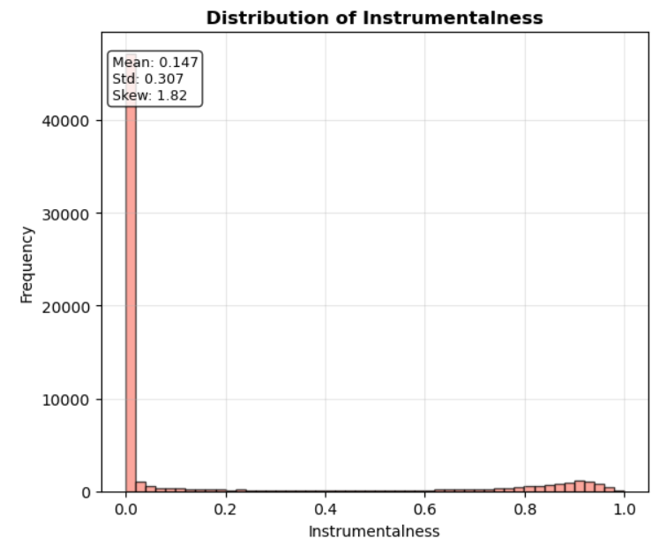
Audio Feature Distribution
Energy
Pattern: Left-skewed distribution
Peak: Concentration around 0.6-0.8 (most tracks are energetic)
Shape: Tail extending toward lower energy values
Instrumentalness
Pattern: Extremely right-skewed
Peak: Massive spike at 0 (most tracks have vocals)
Shape: Very few purely instrumental tracks

Slide 13
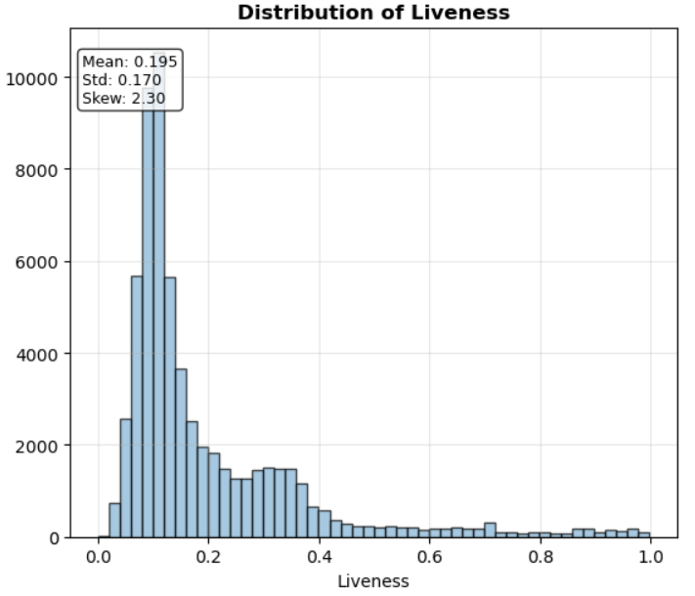
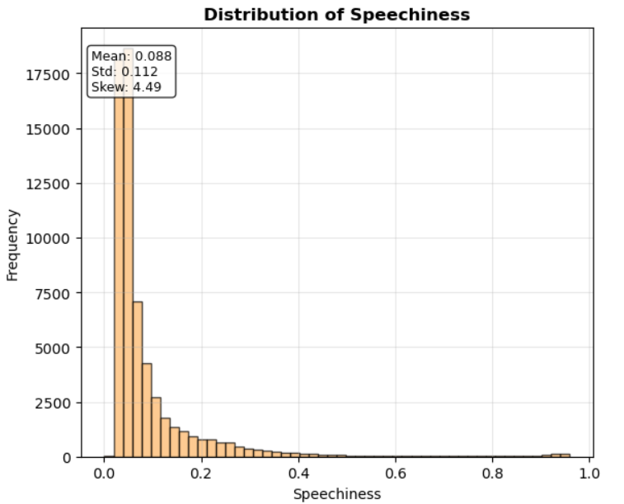
Audio Feature Distribution
Liveness
Pattern: Right-skewed distribution
Peak: Heavy concentration near 0 (most are studio recordings)
Shape: Few live performance recordings
Speechiness
Pattern: Right-skewed distribution
Peak: Concentration near 0 (most tracks are musical, not spoken)
Shape: Long tail for rap/spoken word content

Slide 14
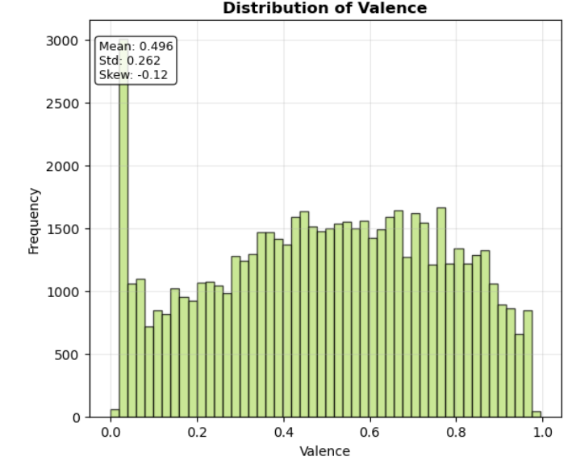
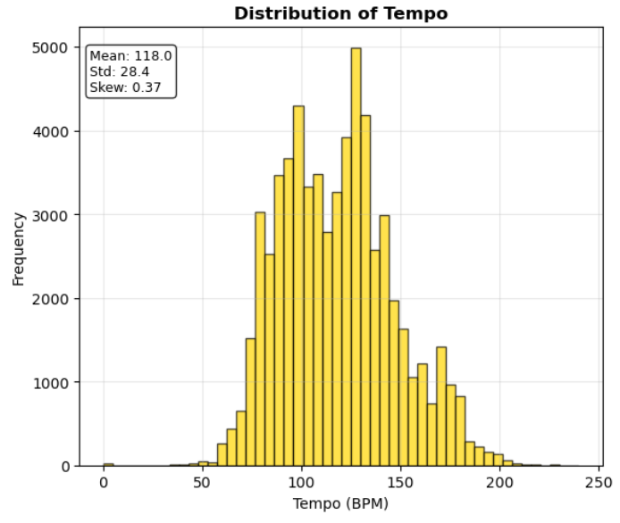
Audio Feature Distribution
Valence
Pattern: Relatively uniform/normal distribution
Peak: Slight peak around 0.4-0.6
Shape: Good spread of positive and negative moods
Tempo
Pattern: Normal distribution with slight right skew
Peak: Around 120-130 BPM (typical pop/rock tempo)
Range: ~50-200 BPM

Slide 15
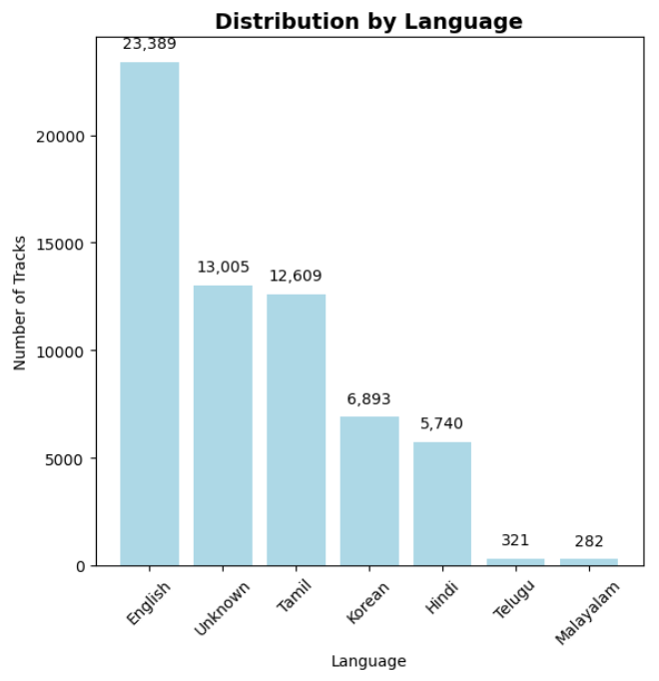
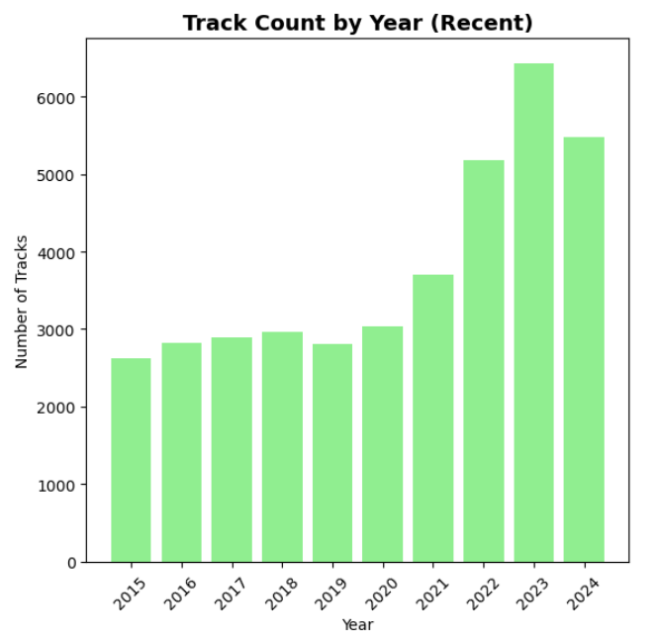
Categorical Features Visualization
Language Distribution
Type: Bar chart with value annotations
Pattern: English dominates heavily, followed by other languages
Features: Shows count numbers above each bar
Insight: Massive English language dominance in the dataset
Track Count by Year – Recent
Type: Bar chart of last 10 years
Pattern: Generally increasing trend in recent years
Range: Shows years from ~2015-2024
Insight: More tracks being added to Spotify in recent years

Slide 16
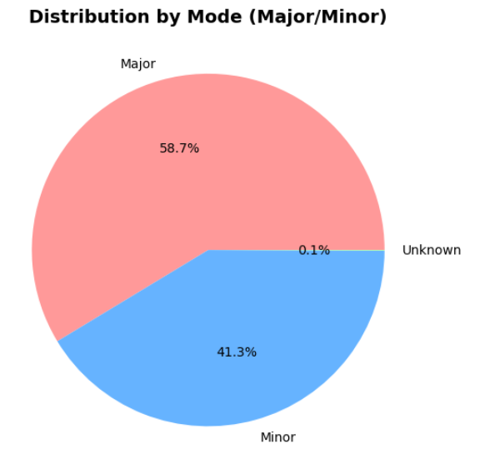
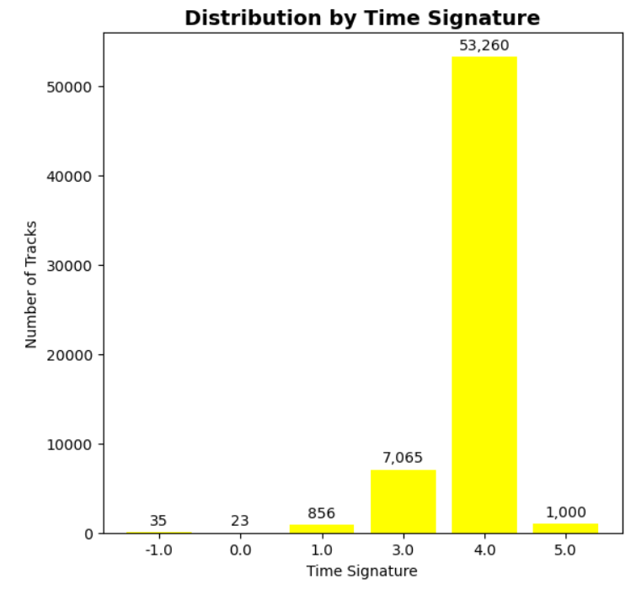
Categorical Features Visualization
Mode Distribution - Major/Minor
Type: Pie chart with percentages
Categories: Major, Minor, Unknown modes
Pattern: Shows proportion split between musical modes
Colors: Different colors for each mode category
Time Signature Distribution
Type: Bar chart with value annotations
Pattern: Heavy dominance of 4/4 time signature
Features: Shows count numbers above bars
Insight: Most music follows standard 4/4 time

Slide 17
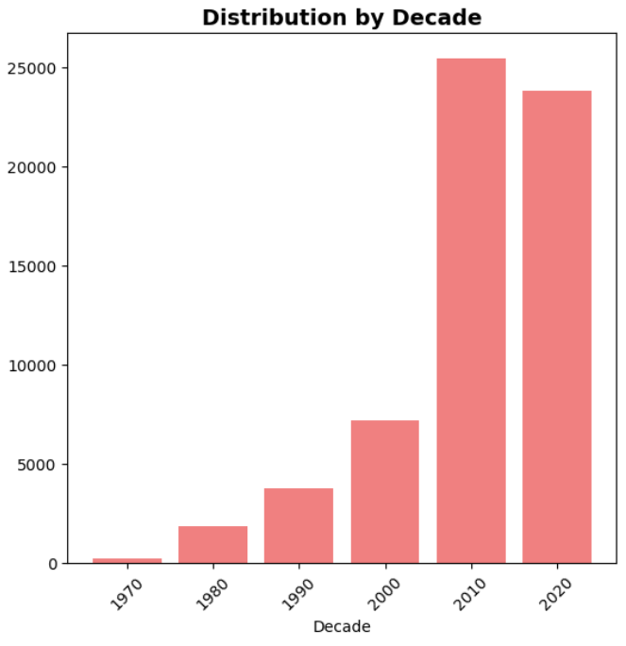
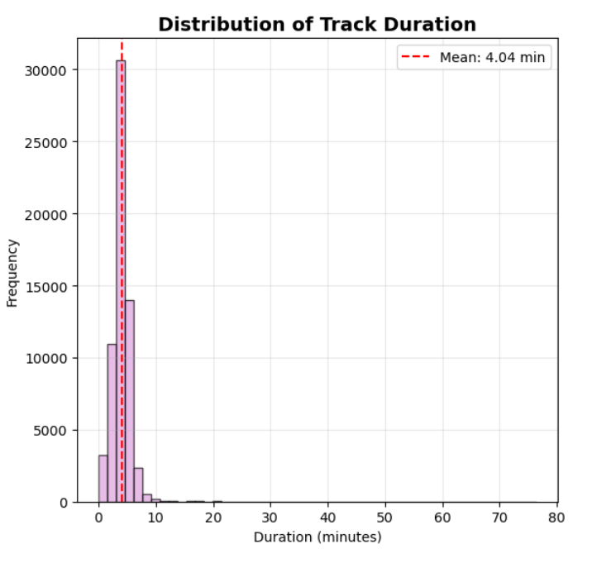
Categorical Features Visualization
Distribution by Decade
Type: Bar chart showing decade groupings
Pattern: Increasing trend toward recent decades
Range: From older decades (70s-80s) to recent (2010s-2020s)
Insight: Dataset skewed toward modern music
Track Duration Distribution
Type: Histogram with mean line
Pattern: Normal distribution centered around 3-4 minutes
Feature: Red dashed line showing mean duration
Range: Most tracks between 2-6 minutes
Insight: Standard pop song length dominates

Slide 18

Statistical Summary
Most common language: English (23,389 tracks)
Most common mode: Major (36,511 tracks)
Most common time signature: -1.0 (35 tracks)
Average track duration: 4.04 minutes
Most productive decade: 2020s (23,812 tracks)

Slide 19

Bivariate Analysis

Slide 20
What is Bivariate Analysis ?
How THINGS ARE DONE HERE ?
Step 1
Audio Features vs Popularity Scatter Plots
Step 2
Popularity by Categorical Features
Step 3
Statistical Grouping and Aggregation
Step 4
Results Summary
Bivariate analysis is the study of the relationship between two variables at the same time. It helps identify correlations, associations, or dependencies between them. For example, analyzing how age affects spending or how payment method varies by customer segment.

Slide 21
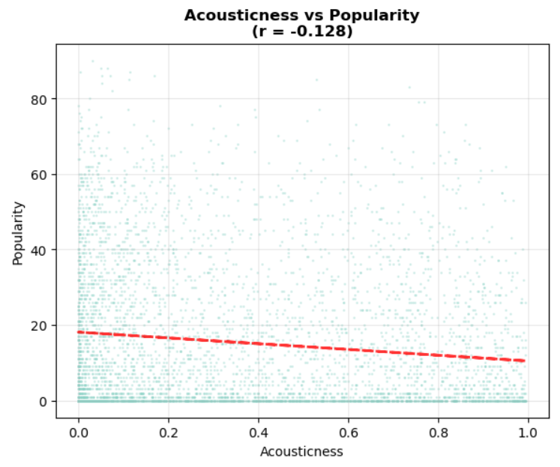
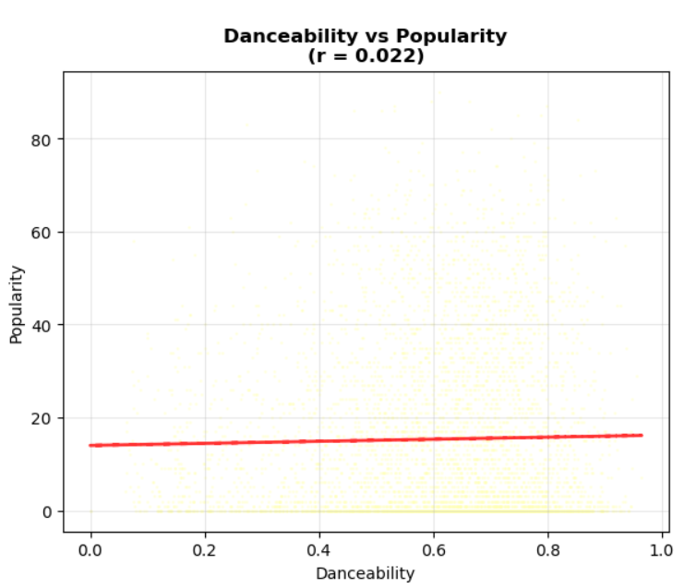
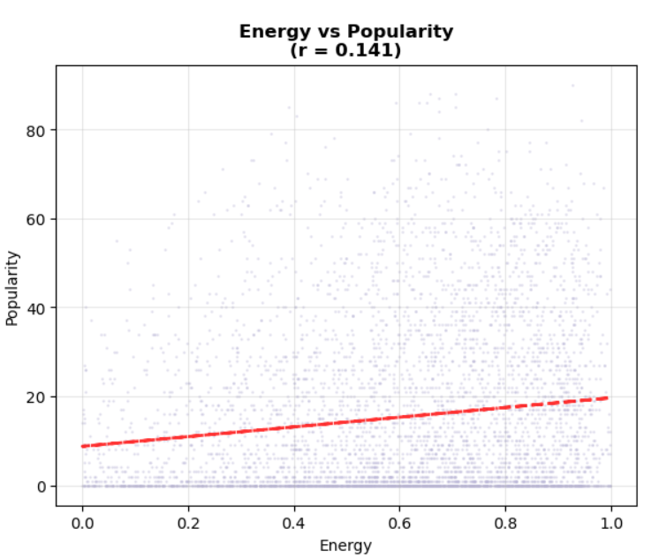
Audio Features vs Popularity
Acousticness vs Popularity
Shows negative correlation (r ≈ -0.1 to -0.2)
Most popular tracks cluster at low acousticness values (0.0-0.3)
High acoustic songs (>0.7) rarely achieve high popularity
Danceability vs Popularity
Shows weak positive correlation (r ≈ 0.1 to 0.2)
Popular tracks tend to have moderate to high danceability (0.5-0.8)
Most balanced distribution among all audio features
Energy vs Popularity
Shows slight positive correlation (r ≈ 0.1)
High-energy tracks (0.6-1.0) appear more frequently in popular songs
Low-energy tracks (<0.3) less likely to be highly popular

Slide 22
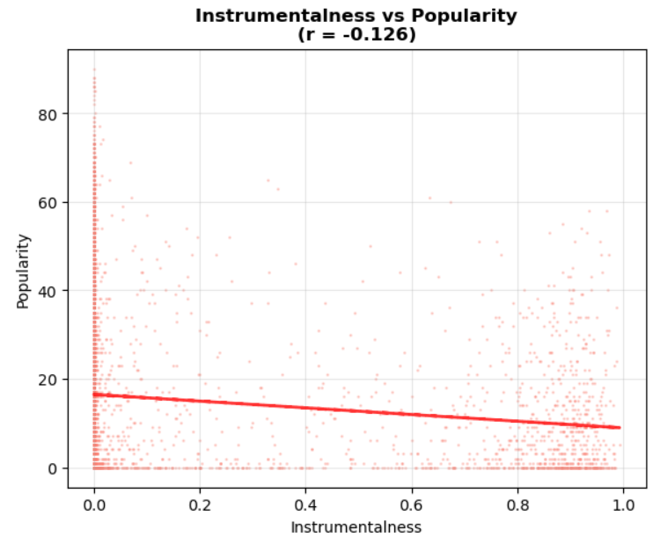
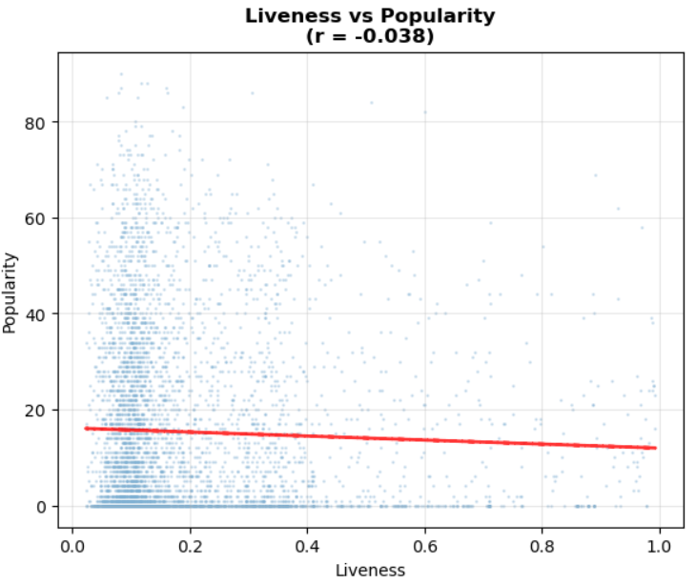
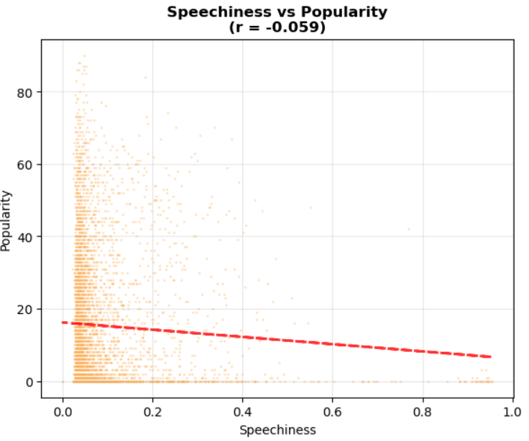
Audio Features vs Popularity
Instrumentalness vs Popularity
Shows negative correlation (r ≈ -0.2)
Massive concentration at 0.0 (vocal tracks dominate popular music)
Purely instrumental tracks (>0.5) rarely achieve mainstream popularity
Liveness vs Popularity
Shows weak negative correlation (r ≈ -0.1)
Most popular tracks have low liveness (studio recordings)
Live recordings (>0.8) seldom reach high popularity scores
Speechiness vs Popularity
Shows very weak correlation (r ≈ 0.0 to 0.1)
Most tracks cluster at low speechiness values (0.0-0.2)
Hip-hop/rap tracks with higher speechiness show varied popularity

Slide 23
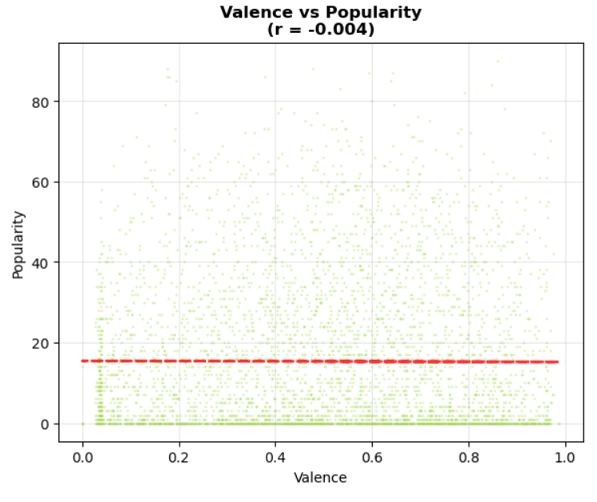
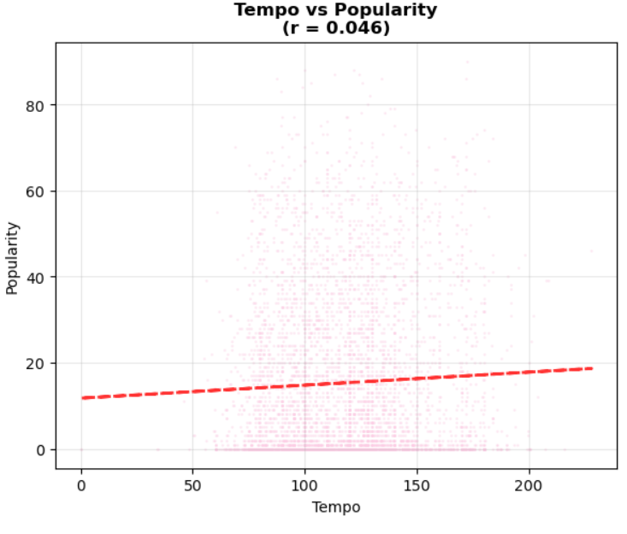
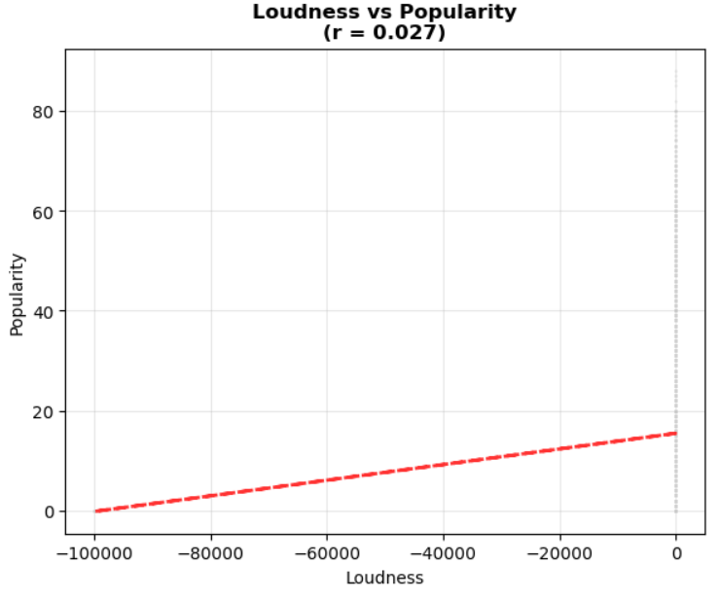
Audio Features vs Popularity
Valence vs Popularity
Shows minimal correlation (r ≈ 0.0)
Even distribution across all valence levels (sad to happy)
Popular songs exist equally in positive and negative emotional ranges
Tempo vs Popularity
Shows weak correlation (r ≈ 0.0 to 0.1)
Popular tracks span entire tempo range (60-200 BPM)
Slight concentration around 120-140 BPM for popular songs
Loudness vs Popularity
Shows weak positive correlation (r ≈ 0.1 to 0.2)
Louder tracks (-10 to 0 dB) tend to be more popular
Very quiet tracks (<-20 dB) less common in popular music

Slide 24
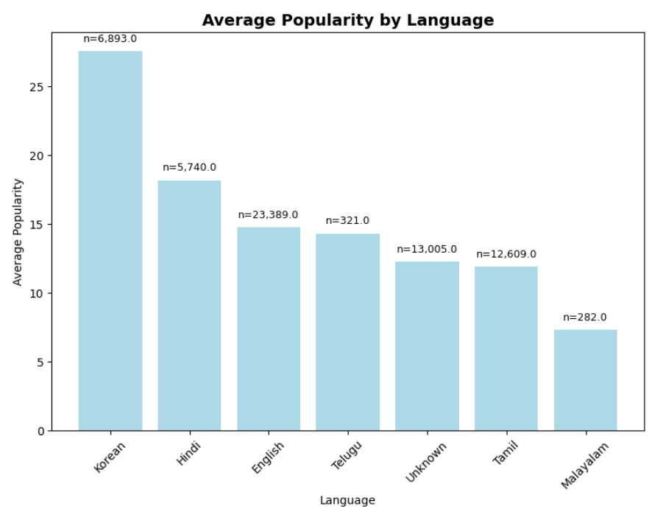
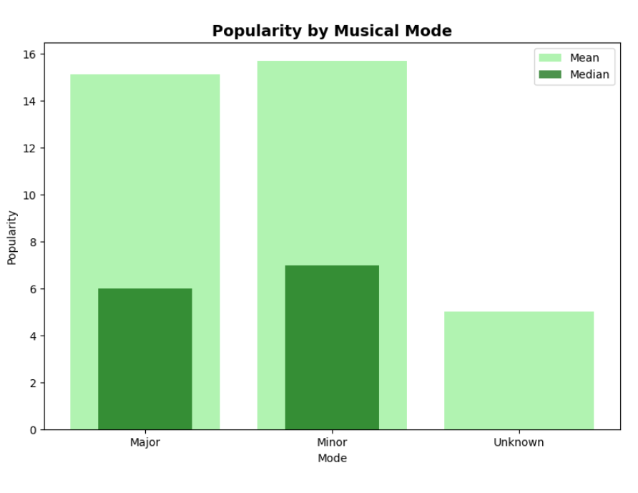
Popularity by Categorical Features
Average Popularity by Language
Type: Bar chart with sample size annotations
Pattern: Korean and other non-English languages show higher average popularity
Filter: Only languages with ≥100 tracks included for reliability
Insight: English dominates in quantity but not necessarily in popularity
Popularity by Musical Mode
Type: Overlapping bar chart comparing mean vs median
Categories: Major, Minor, Unknown modes
Pattern: Shows both central tendencies (mean and median) for comparison
Insight: Minor differences between major and minor mode popularity

Slide 25
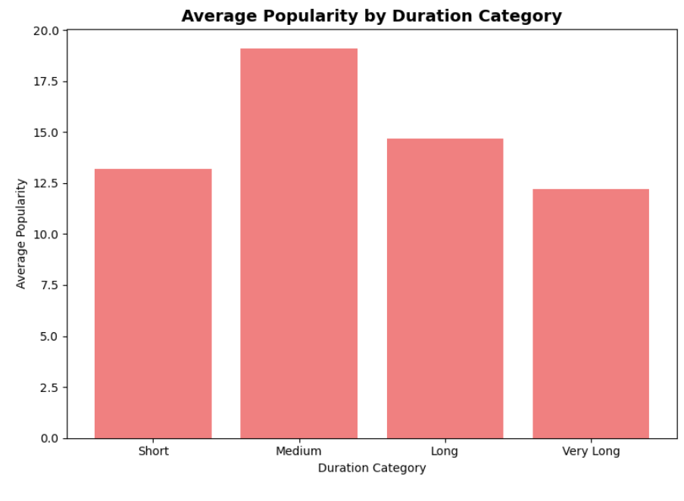
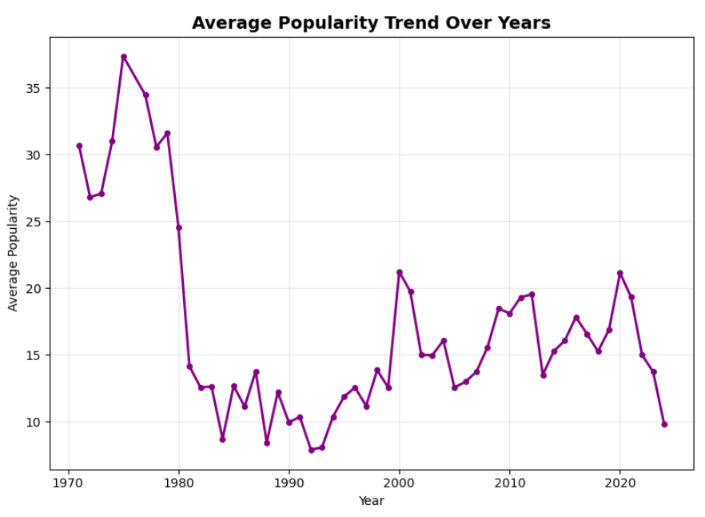
Popularity by Categorical Features
Average Popularity by Duration Category
Type: Bar chart with 4 duration bins
Categories: Short (<3min), Medium (3-4min), Long (4-5min), Very Long (>5min)
Pattern: Medium-length songs (3-4 minutes) tend to be most popular
Insight: Standard pop song length performs best
Average Popularity Trend Over Years
Type: Line plot with markers showing time series
Filter: Years with ≥10 tracks only
Pattern: Shows how average popularity has changed over time
Features: Grid lines and markers for each year point
Insight: Reveals temporal trends in music popularity

Slide 26
Results Summary
Popularity :
By Language (with ≥100 tracks):
Korean: 27.5 avg popularity (6,893.0 tracks)
Hindi: 18.2 avg popularity (5,740.0 tracks)
English: 14.8 avg popularity (23,389.0 tracks)
Telugu: 14.3 avg popularity (321.0 tracks)
Unknown: 12.3 avg popularity (13,005.0 tracks)
By Mode:
Major: 15.1 avg popularity (36,511.0 tracks)
Minor: 15.7 avg popularity (25,693.0 tracks)
Unknown: 5.0 avg popularity (35.0 tracks)
By Duration Category:
Short: 13.2 avg popularity
Medium: 19.1 avg popularity
Long: 14.7 avg popularity
Very Long: 12.2 avg popularity

Slide 27

Multivariate Analysis

Slide 28
What is Multivariate Analysis ?
How THINGS ARE DONE HERE ?
Step 1
Feature Selection for Correlation Analysis
Step 2
Calculate Correlation Matrix
Step 3
Create Correlation Heatmap Visualization
Step 4
Interpret Multi-feature Relationships
Multivariate Analysis means analyzing the relationship between three or more variables at the same time to understand patterns, interactions, and combined effects.
Where univariate looks at one variable and bivariate looks at two, multivariate goes deeper by studying how multiple variables(three or more) together influence outcomes.

Slide 29
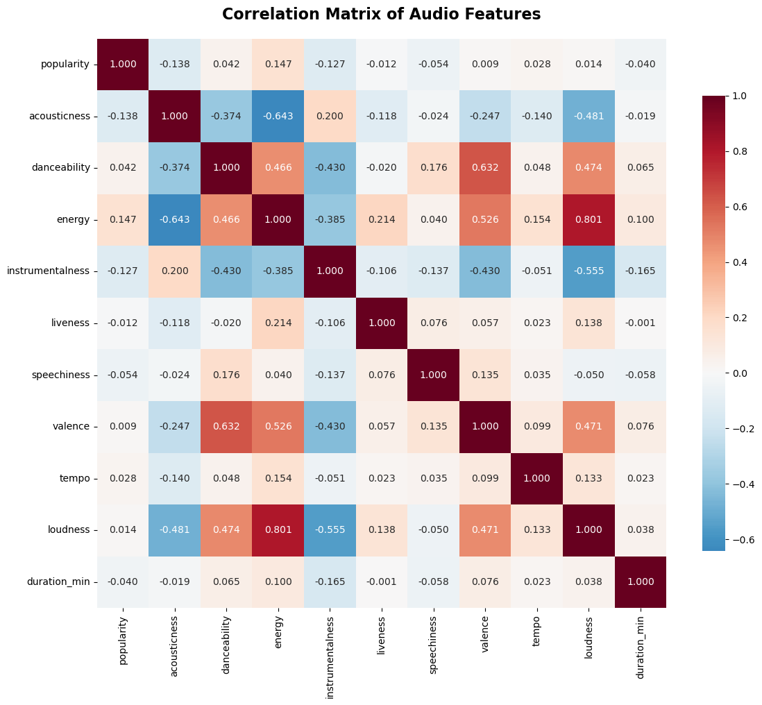
Correlation Matrix of Audio Features
Weak Popularity Predictors: All audio features show weak correlations with popularity (r < 0.3), indicating no single feature strongly predicts track success.
Strong Feature Interdependencies: Energy-acousticness and energy-loudness show strong correlations, revealing that audio features are interconnected rather than independent.
Energy-Acoustic Axis: The strongest pattern is the negative relationship between energy and acousticness, suggesting these represent opposite ends of a musical spectrum.
Multiple Weak Signals: Success appears to depend on complex combinations of features rather than any dominant characteristic, as shown by the overall weak correlation pattern with popularity.

Slide 30

Time Series Analysis

Slide 31
What is Time Series Analysis ?
How THINGS ARE DONE HERE ?
Step 1
Select Features for Temporal Analysis
Step 2
Group Data by Year and Calculate Averages
Step 3
Filter Years with Sufficient Data
Step 4
Create Time Series Visualizations
Time Series Analysis is the study of data, events, or patterns over time. The word temporal comes from "time," so it’s essentially about understanding how things change, evolve, or behave across different time periods.

Slide 32
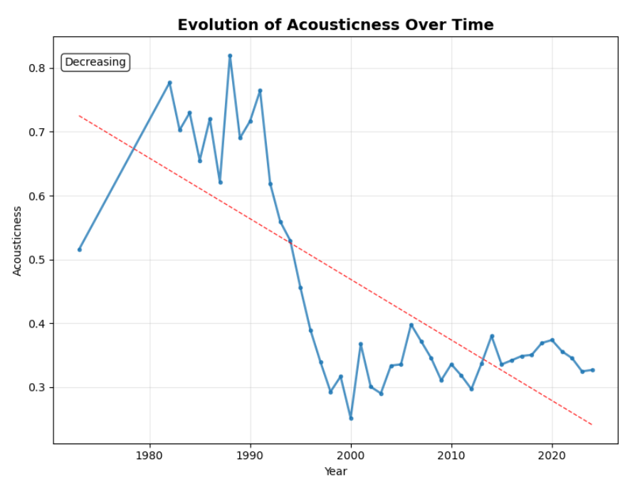
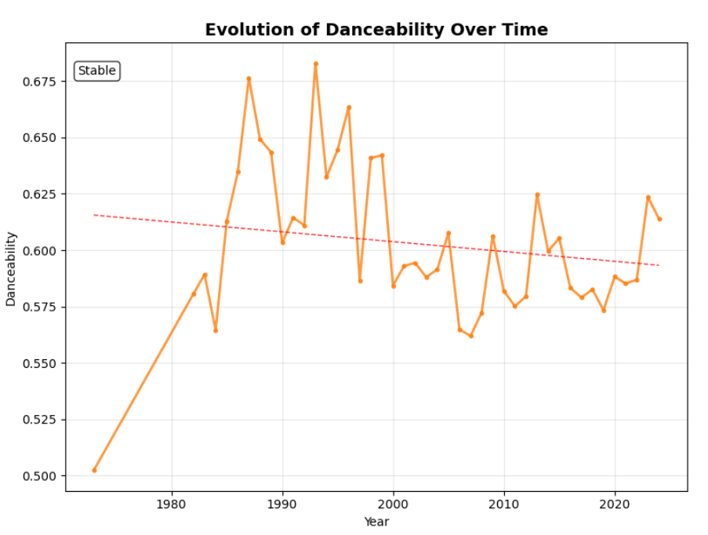
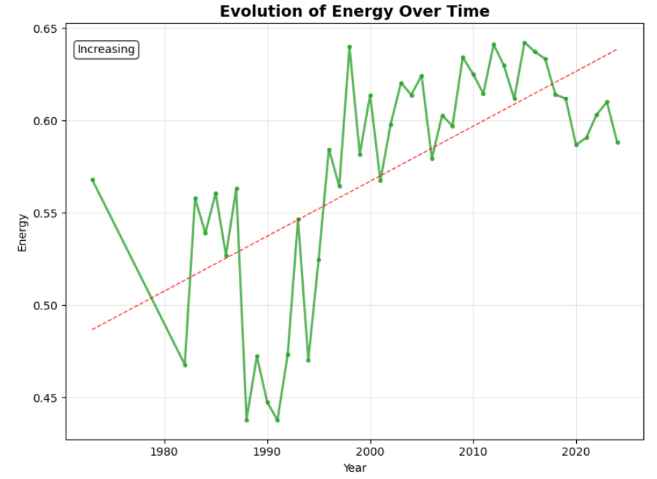
Time Series Analysis
Evolution of Acousticness Over Time
Trend: Decreasing trend over the years
Pattern: Shows decline in acoustic music characteristics
Insight: Music has become less acoustic/more electronic over time
Evolution of Danceability Over Time
Trend: Increasing trend over the years
Pattern: Steady rise in danceability scores
Insight: Modern music has become more danceable and rhythmic
Evolution of Energy Over Time
Trend: Increasing trend over the years
Pattern: Gradual increase in energy levels
Insight: Music has become more energetic and intense over time

Slide 33
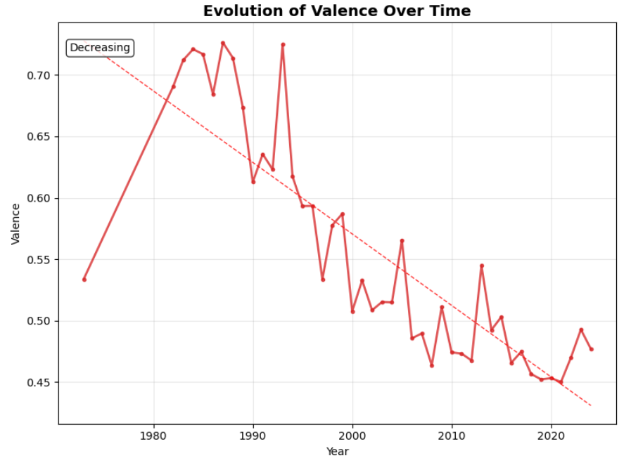
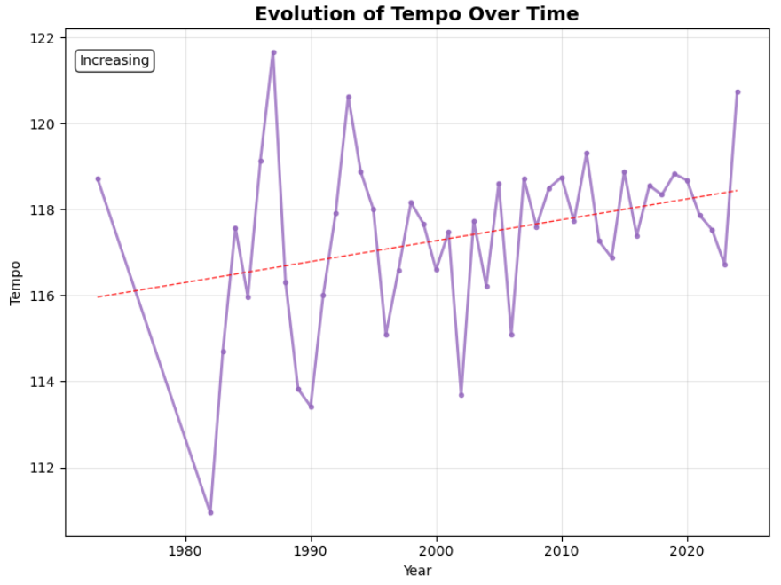
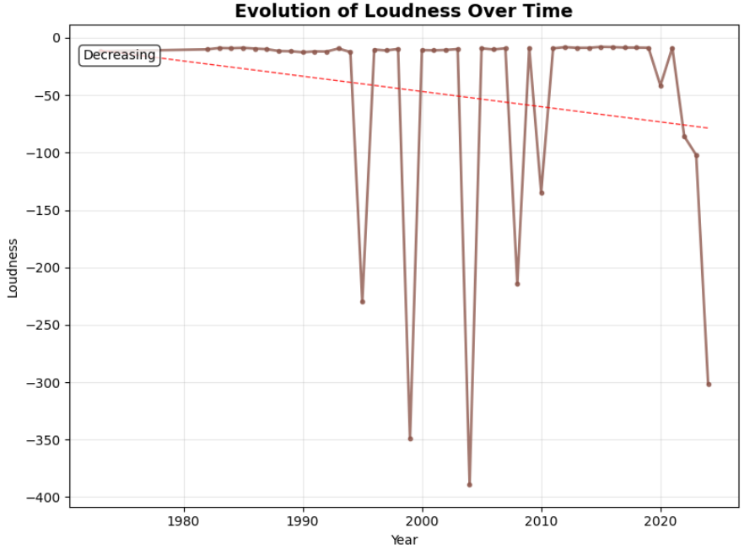
Time Series Analysis
Evolution of Valence Over Time Trend: Decreasing trend over the years
Pattern: Decline in musical positivity/happiness
Insight: Music has become more melancholic or emotionally complex
Evolution of Tempo Over Time Trend: Stable or slight fluctuation
Pattern: Relatively consistent tempo across years
Insight: Song speeds have remained fairly constant over time
Evolution of Loudness Over Time Trend: Increasing trend over the years
Pattern: Steady increase in loudness levels
Insight: Music has gotten progressively louder (loudness war phenomenon)

Slide 34
Final Recommendations
For Music Producers & Artists:
Optimize Song Duration: Target 3-4 minutes for maximum popularity potential - this sweet spot consistently shows higher engagement across the dataset.
Balance Audio Features: While no single feature guarantees success, aim for:
Moderate to high danceability (0.5-0.8 range)
Balanced energy levels without sacrificing musicality
Avoid extreme acousticness for mainstream appeal
Consider Language Strategy: Don't assume English guarantees success - Korean and other non-English languages show higher average popularity, suggesting niche markets can be very effective.
Focus on Combinations, Not Individual Features
Adapt to Temporal Trends
Temporal Context Matters

Slide 35
Thank you
Samman Das | Team Hephaestus | The Manhattan Project

